Slide 1
Lecture 1: Overview and Evaluation Criteria of Programming Languages
CS4080
(Chapter 1 & Chapter 2)

Slide 2
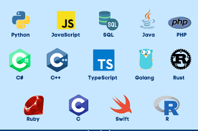
Part 1: Overview of Programming Languages (PLs)

Slide 3
Why study the “concepts of PLs”?
Increased ability to express ideas
Use appropriate language features in program development
Improved background for choosing appropriate languages
e.g. what language to use for an AI application?
Increased ability to learn new languages
Yes, everyone will learn a new language this semester.
Better understanding of the significance of implementation
How recursion implemented?
Which implementation more efficiency?
Overall advancement of computing
History will teach us “a lot of things”.
Looking back the languages used in the past you’d much appreciate the ones we’re using now.
Notes:
3

Slide 4
Programming Domains
Scientific applications
Large numbers of floating point computations; use of arrays
Fortran, C++, C, …
Business applications
Produce reports, use decimal numbers and characters
COBOL, SQL, PL/B, Java, C#(.NET) …
Artificial intelligence
Symbols rather than numbers manipulated; use of linked lists
LISP, Prolog, C++, …
Systems programming
Need efficiency because of continuous use
C, C++, PL/I, GO (google), …
Web Software
Collection of languages: markup (e.g., XHTML), scripting (e.g., PHP), general-purpose (e.g., Java)
Notes:
4

Slide 5
Language Categories
Imperative
Central features are variables, assignment statements, and iteration
Include languages that support object-oriented programming
Include scripting languages
Include the visual languages
Examples: C, Java, Perl, JavaScript, Visual BASIC .NET, C++
Functional
Main means of making computations is by applying functions to given parameters
Examples: LISP, Scheme
Logic
Rule-based (rules are specified in no particular order)
Example: Prolog
Markup/programming hybrid
Markup languages extended to support some programming
Examples: JSTL, XSLT
Notes:
5

Slide 6
Domain Specific Languages (DSLs)
A domain-specific language (DSL) is a computer language specialized to a particular application domain. [Wikipedia]
General-purpose languages (GPLs): broadly applicable across domains.
Varieties of DSLs
domain-specific markup languages
widely used languages for common domains, such as HTML for web pages
domain-specific modeling languages
specification languages
domain-specific programming languages
used by only one or a few pieces of software

Slide 7
Domain Specific Languages (DSLs)
Case Studies
P4 is a programming language for controlling packet forwarding planes in networking devices, such as routers and switches
Others?
Discussion
The line between general-purpose languages and domain-specific languages is not always sharp
Perl: designed for text processing but later used as a GPL
postscripts: in principle can be used for any task, but in practice is narrowly used as a page description language.

Slide 8
Language families: contrast
//C -- imperative
int gcd (int a, int b) {
if (a == b) return a;
else if (a > b)
return gcd(a-b, b);
else return (a, b-a);
}
#Scheme -- functional
(define gcd
(lambda (a b)
(cond ((= a b) a)
((> a b) (gcd (- a b) b))
(else (gcd a (- b a))))))
%Prolog – logic
gcd(A,B,G) :- A = B, G=A.
gcd(A,B,G) :- A>B, C is A-B, gcd(C,B,G).
gcd(A,B,G) :- B>A, C is B-A, gcd(C,A,G).

Slide 9
Influences on Language Design
Computer Architecture
von Neumann architecture
Stored program concepts
Variables model memory cells
Parallel computers and multicores
Concurrency, multithreading, …
Quantum computing
Programming design methodologies
Object-oriented programming
Data-oriented vs. procedure oriented

Slide 10
Implementation Methods
Compilation
Translate source code to object/machine code
Main modules
Syntax analysis, semantics analysis, code generation
Executable user code and system code are linked together and loaded to system before execution
Linking and loading process
Pure interpretation
A software, called interpreter, acts as a software simulation of a machine
Provides a virtual machine for the language
Hybrid implementation system
Translate into intermediate code that allows easy interpretation

Slide 11
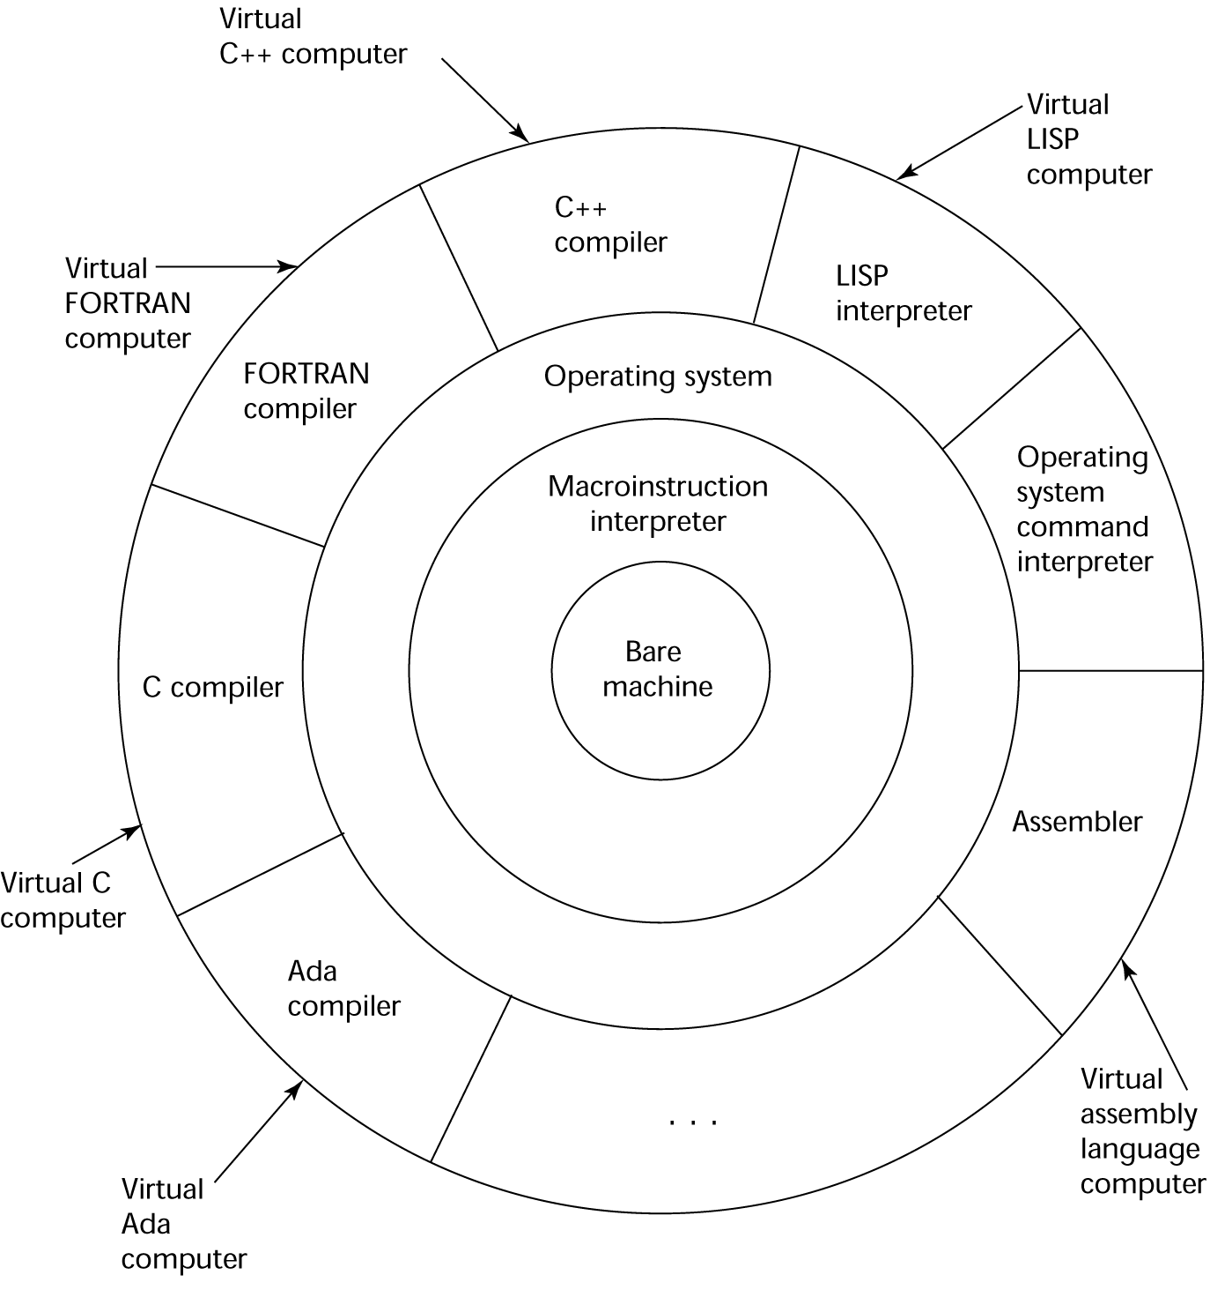
Layered View of Computer
The operating system and language implementation are layered over
machine interface of a computer

Slide 12
Compilation Process

Slide 13
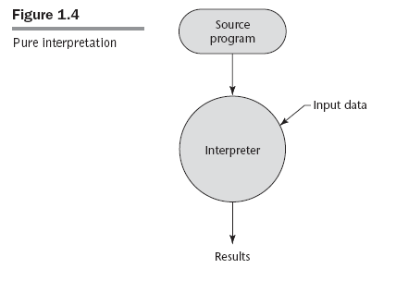
Pure Interpretation

Slide 14
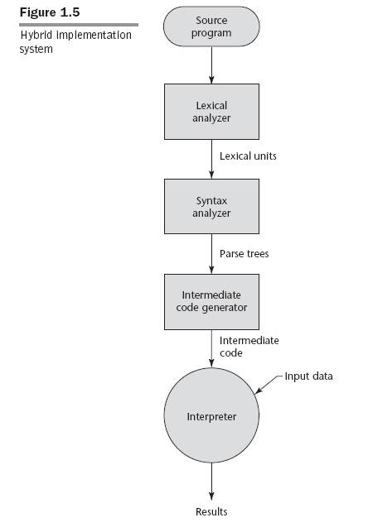
Hybrid

Slide 15
Just-in-Time Implementation Systems
Initially translate programs to an intermediate language
Then compile the intermediate language of the subprograms into machine code when they are called
Machine code version is kept for subsequent calls
JIT systems are widely used for Java programs
.NET languages are implemented with a JIT system
In essence, JIT systems are delayed compilers

Slide 16
Programming Environment
A collection of tools used in the development of software
Tools
file system, text editor, compiler/linker, …
Could also be a large collection of integrated tools
Examples
Unix environment
Borland Jbuilder (for Java development)
NetBeans (for Java applications but also support JavaScript, Ruby, and PHP)
Microsoft Visual Studio .Net

Slide 17
Genealogy of Common Languages
Figure 2.1

Slide 18
Why “high-level” programming languages?
What was wrong with using machine code?
Poor readability
Poor modifiability
Expression coding was tedious
Machine deficiencies--no indexing or floating point
Example; x86 instruction set machine code for GCD program
55 89 e5 53 83 ec 04 89 e4 f0 e8 31 00 00 00 90 c3 e8 2a 00
00 00 39 c3 74 10 8d b6 00 00 00 00 39 c3 7e 13 29 c3 39 c3
75 f6 89 1c 24 e8 6e 00 00 00 8b 5d fc c9 c3 29 d8 eb eb 90

Slide 19
Machine code, assembly, high-level programs
GCD program in x86 assembly language
The first few lines of the GCD assembly code …
pushl %ebp
movl %esp, %ebp
pushl %ebx
subl $4, %esp
andl $-16, %esp
…
Can you write a GCD program in Java/C++/Python?

Slide 20
What could we learn from the history?
Understand obscure features
E.g. C++: union type, multiple inheritance, * operator (in pointers) …
Why they’re gone?
Choose among alternative ways to express things
E.g. copy constructor vs. extra assignment
Simulate useful features in languages that lack them
E.g. iterator
Make better use of technology
Web-based language such as XML, etc.
…

Slide 21
Part 1: Learning Objectives
After studying the Part 1 of Lecture 1, you should be able to
Describe the history and development of programming language design
Discuss what could we learn from the history?
Classify Languages based on language features and application domains
Language categories
Discuss the perspectives and current issues in language design

Slide 22
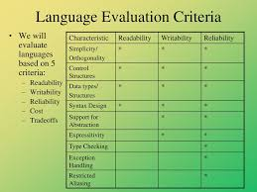
Part 2: Language Evaluation Criteria

Slide 23
Which programming language is the “best”?
No “best”, but look for “better”
Programming domain specific
E.g. Business vs. System programming
Bad design or good design?
Many design choices
E.g. case sensitive vs. case insensitive
Not wrong or right, but which one is better?
Language features are important
Languages of different category may offer different features
E.g. functional languages vs. mark-up languages
We will focus on feature comparisons of similar languages
E.g. lists. vs. arrays
E.g. should we have a switch statement or not?
Notes:
23

Slide 24
Language Evaluation Criteria
Readability: the ease with which programs can be read and understood
Syntax, data types, …
Writability: the ease with which a language can be used to create programs
Support for abstraction, expressivity (operators, predefined functions, …)
Reliability: conformance to specifications (i.e., performs to its specifications)
Type checking, exception handling, …
Cost: the ultimate total cost
Training programmers, compiling/executing programs, implementation, …
Portability, generality, …
Notes:
24

Slide 25
Which one has better readability?
//C:
int gcd (int a, int b) {
if (a == b) return a;
else if (a > b)
return gcd(a-b, b);
else return (a, b-a);
}
#Scheme:
(define gcd
(lambda (a b)
(cond ((= a b) a)
((> a b) (gcd (- a b) b))
(else (gcd a (- b a))))))
%Prolog
gcd(A,B,G) :- A = B, G=A.
gcd(A,B,G) :- A>B, C is A-B, gcd(C,B,G).
gcd(A,B,G) :- B>A, C is B-A, gcd(C,A,G).
Answers may be subjective, but here, the ”readability” criterion attempts to set a common ground.

Slide 26
Which one has better writability?
//C:
int gcd (int a, int b) {
if (a == b) return a;
else if (a > b)
return gcd(a-b, b);
else return (a, b-a);
}
#Scheme:
(define gcd
(lambda (a b)
(cond ((= a b) a)
((> a b) (gcd (- a b) b))
(else (gcd a (- b a))))))
%Prolog
gcd(A,B,G) :- A = B, G=A.
gcd(A,B,G) :- A>B, C is A-B, gcd(C,B,G).
gcd(A,B,G) :- B>A, C is B-A, gcd(C,A,G).

Slide 27
Discussion Questions (which? why?)
Which one has better writability?
Java, JavaScript, Ruby, Python, …?
Which one is more reliable?
Java, C++, C#, Ada, …?
Which one has better (execution) performance?
Java, C, Python, Ruby, …?
Which language is the best to learn as the 1st programming language?
Java, Python, Visual Basic, …
Assume you took CS4110 and you’re assigned to write a compiler for a PL, which task is the easiest?
Java, FORTRAN, Ada, Pascal, …

Slide 28
Readability & Writability: which one better?
if (ans == ‘A’) {
… call fa();
}
else if (ans == ‘B’) {
… call fb();
}
else if (ans == ‘C’) {
… call fc();
}
else {
… call ff();
}
switch (ans) {
case ‘A’ : fa(); break;
case ‘B’ : fb(); break;
case ‘C’ : fc(); break;
default: ff();
}

Slide 29
Readability & Writability: which one better?
if (ans == ‘A’) {
… call fa();
}
else if (ans == ‘B’) {
… call fb();
}
else if (ans == ‘C’) {
… call fc();
}
else {
… call ff();
}
if ans == ‘A’ :
… call fa();
elif ans == ‘B’ :
… call fb();
elif ans == ‘C’ :
… call fc();
else :
…call ff();

Slide 30
Feature comparison
Some language features embedded/inherent in coding
Java vs. C++
array index checking
which one has better reliability?
which one costs more?
//Java – observe the execution
int[] a = new int[5];
for (int i=1; i<=5; i++)
a[i] = 100;
//C++ – observe the execution
int a [5]; //or int *a = new int[5];
for (int i=1; i<=5; i++)
a[i] = 100;

Slide 31
Introducing a new feature
Example
980_000_000 a valid Java numeric literal?
if no, why Java avoids such format?
if yes, why Java supports such format?
98_ _98 valid?

Slide 32
Language Design Trade-Offs
Reliability vs. cost of execution
Example: Java demands all references to array elements be checked for proper indexing, which leads to increased execution costs
Readability vs. writability
Example: APL provides many powerful operators (and a large number of new symbols), allowing complex computations to be written in a compact program but at the cost of poor readability (attachment: APL keyboard image)
Writability (flexibility) vs. reliability
Example: C++ pointers are powerful and very flexible but are unreliable
Notes:
32

Slide 33
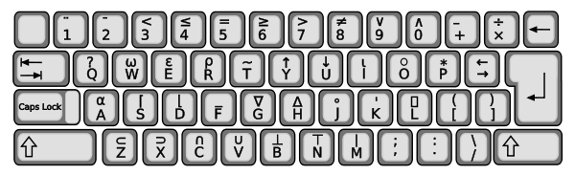
APL keyboard
Discussion question: Pros and Cons of APL’s design philosophy?
APL references:
https://en.wikipedia.org/wiki/APL_(programming_language)
https://computerhistory.org/blog/the-apl-programming-language-source-code/

Slide 34
Pitfalls in applying criteria
How Subjective/Objective?
Which of the following codes you like more?
Or, which of the following codes you think better?
//Java or C++ #Python
if (a < b) { if a < b :
sum += a; sum += a
less++ less += 1
}

Slide 35
Restating the question:
(a) Which code has better readability?
(b) Which code has better writability?
Will that change your vote?

Slide 36
Which Criterion more important?
Is “readability” more important than “writability”?
Should the “cost” the No. 1 criterion?
Should we enforce high “reliability” in every language?
Are “portability” or “generality” less important?
Answer may vary with specific applications/usages, …
In this course, we focus on the criteria “readability”, “writability”, and “reliability” equally, also with some consideration to “cost”.

Slide 37
Learning Objectives
After studying the Part 2 of Lecture 1, you should be able to:
Apply a set of language evaluation criteria such as readability, writability, … in an attempt to provide a non-biased, objective way of evaluation
Describe and discuss the trade-offs among the evaluation criteria

Slide 38
Activity 1 Introduction of Group’s Language
This is a group-based assignment.
Each of you should join a language group.
If you don’t have a group yet, please contact me.
Each group will make a presentation (3-5 minutes) to introduce your language.
Activity 1 covers two parts
Part A: Form groups
Part B: Language introduction

Slide 39
Part B of Activity 1: Language Introduction
History, Origin, and any fun facts about the language
Suggested Part A presentation topics:
Who designed this language?
What is the design goal of this language?
What languages are its ancestors?
What it differs from its ancestors?
What it learned from the history?
In which way your language is better than its ancestors?
What new feature (by the time of its first publication) did this language introduce, if any?
Why are you interested in this language?
How widely used is the language?
Don’t have to answer all the questions exactly as listed.
Feel free to introduce your language in your own way.

Slide 40
Java Group – short version
Members: Lan & Charlotte
Java: originally developed by James Gosling at Sun Microsystems
Initially to meet a need for a reliable language for communication in embedded devices
first released in 1995 as a general purpose language
Now acquired and maintained by Oracle
Strongly influenced by C/C++
Java is more reliable than its ancestors, and
Better OOP features
Interested in learning Java
Java is hot!
Popularly used in industry.

Slide 41
Part B of Activity 1: Language’s syntax definition
details to be discussed next lecture
Find a site with formal syntax/grammar description for your language (note: there may be multiple sites, try to find one with EBNF like description.)
e.g. (assume I’m the Java group), the site I found is:
https://docs.oracle.com/javase/specs/jls/se13/html/index.html

Slide 42
Activity A1 – Deliverables
Presentation
Penalty taken for absences
One-time absence may be excused given for reasonable (and prior unless emergency) justification
Slides submission on Canvas assignment
Due date(s): see Canvas

